Slide 1

News Bytes
August 2014

Slide 2
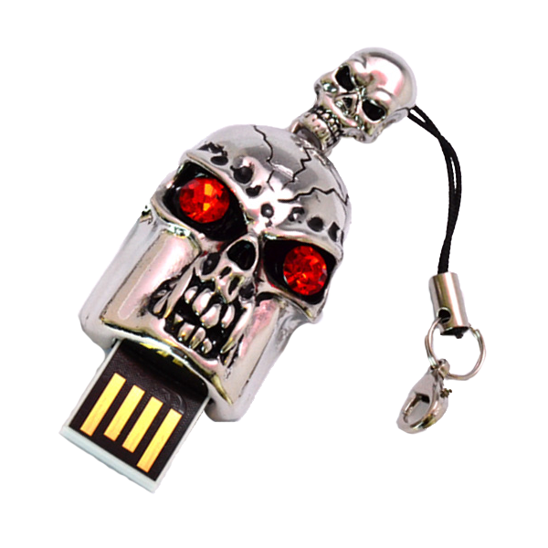
Bad USB
Created by SRLabs
Infects USB firmware to emulate other devices
Paper presented at BlackHat USA 2014.
No effective solution
May require rewriting USB infrastructure/drivers.
Notes:
Emulation:
Keyboard: Automatically executes commands.
DiskDrive: Infect the system on early boot time.
Network Card: Change routing table, DNS entries,…

Slide 3

EMET 5.0
Enhanced Mitigation Experience Toolkit
Forces/enhances security features
DEP
ASLR
NEW
Attack Surface Reduction
Blocking Old ActiveX
Notes:
Supports Vista SP2 +

Slide 4

Android FakeID
One app can impersonate as another app
A malware impersonating an AntiVirus.
Affected Versions 2.1 - 4.4
Patches are available for 4.1,4.2,4.3,4.4
Do not side-load apps
Do not use untrusted Marketplaces.
Notes:
Patches are available for 4.1,4.2,4.3,4.4

Slide 5

WordPress
WordPress 3.9.2 released.
Security Fixes
XML Entity Expansion Attack(DoS)
Possible Code Execution in widgets processing.
Information Disclosure in external GetID3 library.
Brute force attack against CSRF token.
XSS
50,000 sites attacked via MailPoet plugin.
Fixed in 2.6.10
Notes:
XML Entity Expansion: 2 KB document expands to 2.5 GB.
First joint security effort of WP and Drupal.

Slide 6

More…
76,000 Mozilla developer emails leaked.
With 4000 password hashes.
First Bitcoin ATM opened in Las Vegas.
Yahoo to offer end-to-end encrypted (PGP) mail from next year.
Russian Government asked Apple to provide Source Code for Mac and iOS.
Xiaomi phones secretly sending data to Chinese servers.
Notes:
Due to failure of sanitization process.
3. With help of Google.

Slide 7

Tools
Encrypted call service “Signal” launched for iPhone.
Bit-torrent launched Bleep Messenger
Server Less/P2P
Free Cyptolocker Decrypter released.
By FireEye and Fox-IT
Upload once encrypted file and get the key to decrypt all.
https://www.decryptcryptolocker.com/

Slide 8

Recent Conferences
BlackHat USA 2014
Dates: 2nd-7th August 2014
https://www.blackhat.com/us-14/archives.html
DefCon-22(2014)
Dates: 6th-7th August 2014
https://www.defcon.org/html/links/dc-archives.html
Hope X
Dates: 18th-20th July 2014
http://www.hope.net
Notes:
To read/watch archives.
HopeX: Snowdens Keynote.

Slide 9

Upcoming Conferences
c0c0n
Kochi, India
21st (Workshop ), 22nd-23rd (Conference )August 2014
Appsec USA
Denver, CA, USA
16th -17th (Training), 18th-19th (Conference) September 2014

Slide 10

Call For Papers
NullCon 666 (2015) CFP
Last Date: 1st November 2014
Conference: 6th-7th February 2015
Location: Goa, India
ZeroNights
Last Date: 1st October 2014
Conference: 13th -14th November 2014
Location: Moscow, Russia

Slide 11

That’s All
Till Next Time.

